Slide 1
The Internet for Social Machines
The end of data sharing as we know it
FAIR > The Machine Knows what I Mean
Barend Mons & Marco Roos

Slide 2
The Internet of FAIR data and Services
The Internet for Social Machines
The end of data sharing as we know it

Slide 3

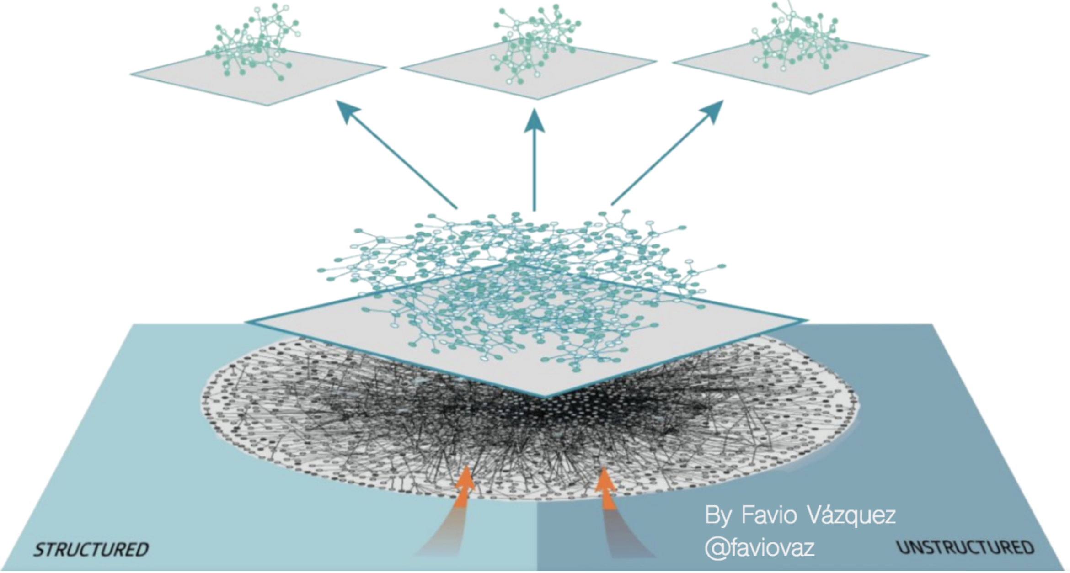
Distributed learning by VM’s

Slide 4
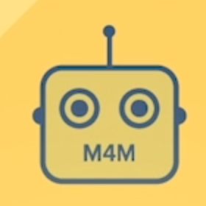
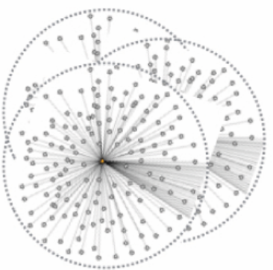
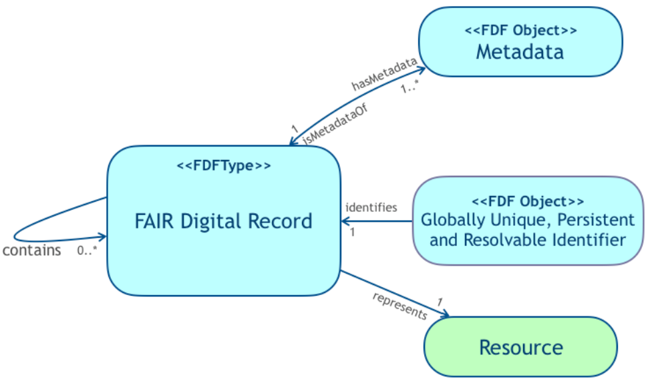
FAIR
Machines know what it means
2
1
3
?
?
?
Digital/physical Resource/Object /Construct
what operations
are possible?
what (type) is it?
what operations
are allowed?
Semantic descriptions
Types/operations
4
operation
Notes:
The core of the hourglass: see: https://www.dropbox.com/s/tzp372c8ffxpwie/open%20declaration%20fdof.pdf?dl=0\

Slide 5
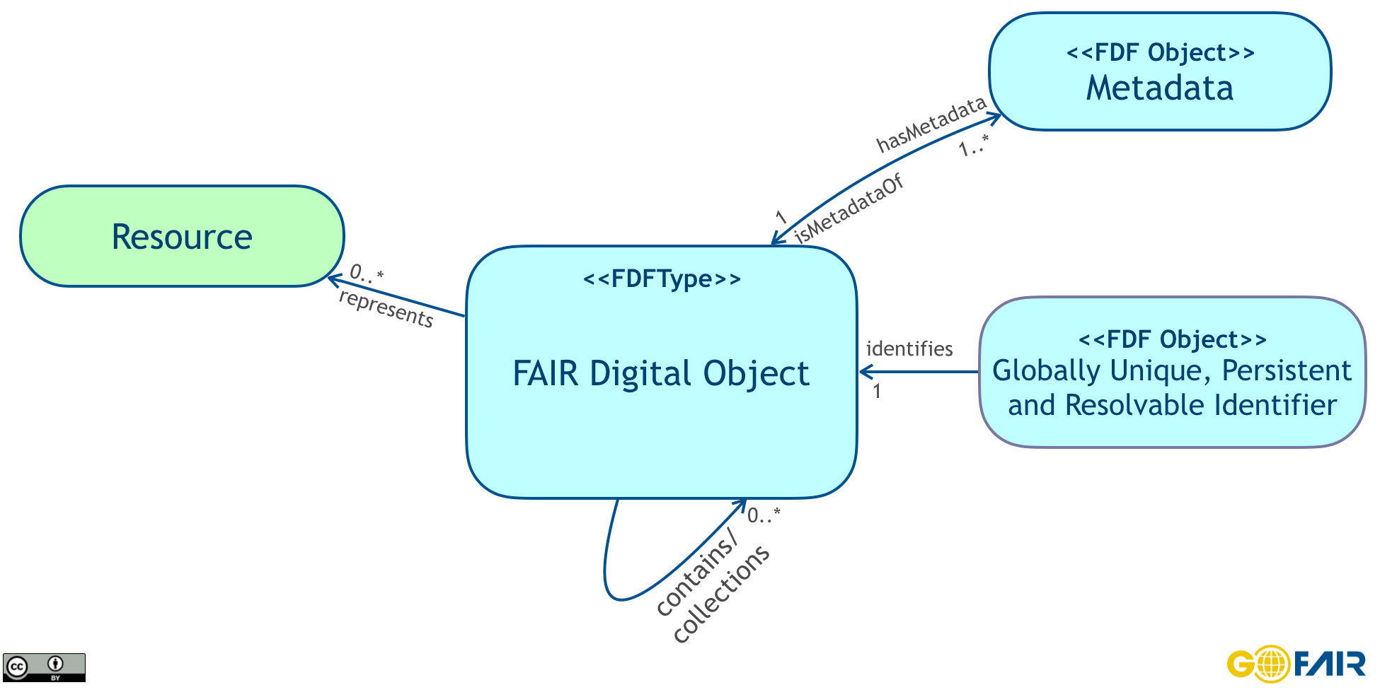

Slide 6
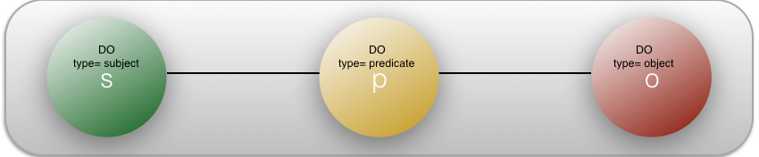
RDFTriple

Slide 7
Nanopub

Slide 8
Workflow

Slide 9

<Type> Nanopublication
GUPRI
provenance (metadata)
FDO
GUPRI
GUPRI
FDO
s
p
o
FDO
FDO
FDO
GUPRI
GUPRI
GUPRI

Slide 10
A
<Type> Nanopublication
provenance
A nanopublication is the smallest meaningful assertion,
minimally one Subject-Predicate-Object triple
S,P, & O are all concepts and thus all have Unique,
Persistent and Resolvable Identifiers. Many nanopublications are
small graphs with multiple triples forming the assertion
s
p
o
provenance
B
<Type> Nanopublication
Two nanopublications representing the same meaningful assertion,
i.e. the Subject-Predicate-Object triples are identical
may have different provenance (they come from different sources)
They each have their Persistent and resolvable Identifier.
and different provenance graphs
s
p
o
provenance
C
<Type> Cardinal Assertion
provenance
s
p
o
A Cardinal Assertion is one assertion that is linked to 1-n
provenance graphs (up to thousands in some cases)

Slide 11
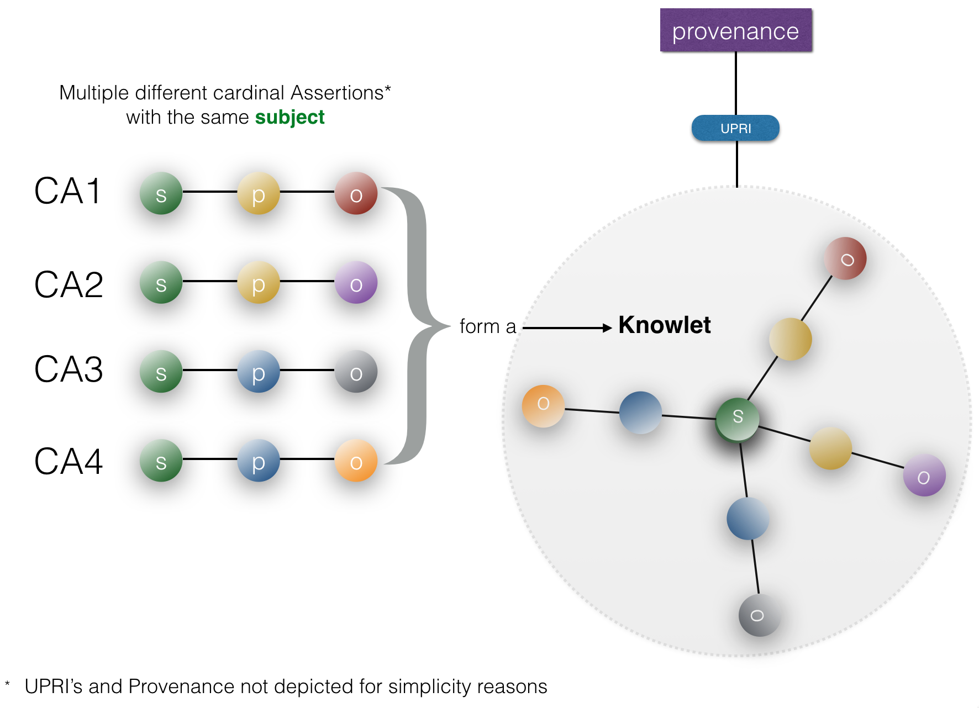

provenance
14
s
p
o
s
p
o
11
provenance
6
GUPRI
5
G

Slide 12
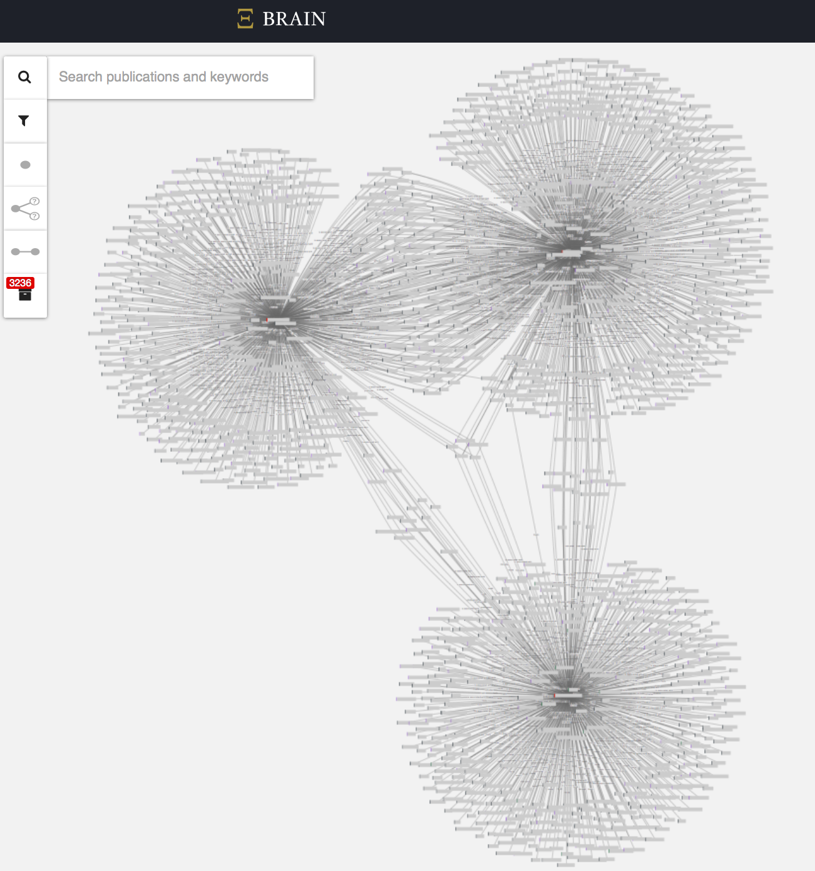
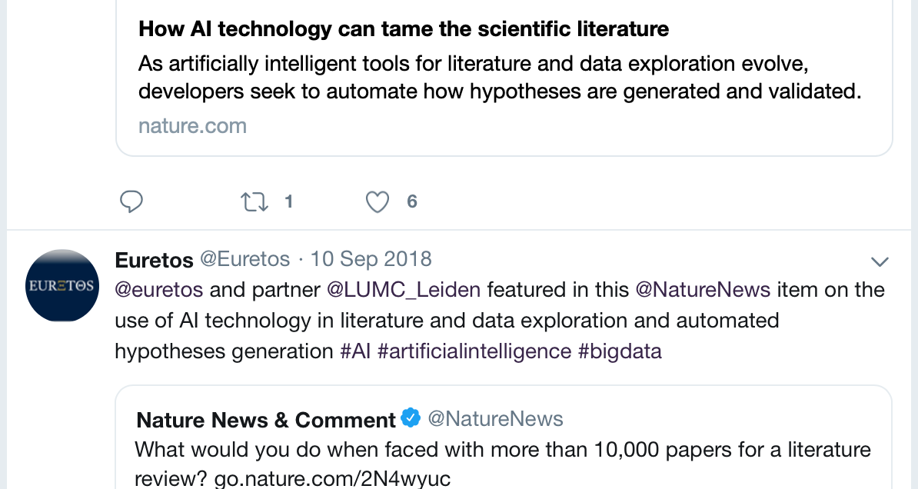
5 objects (genes/proteins and metabolites) are shared between all three Knowlets
(in this case: metabolic syndrome, diabetes type-2, and early onset Alzheimer)

Slide 13
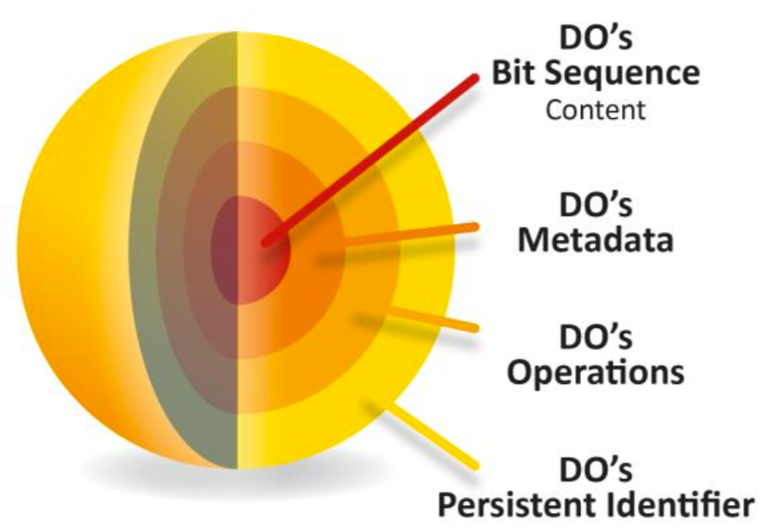

Slide 14
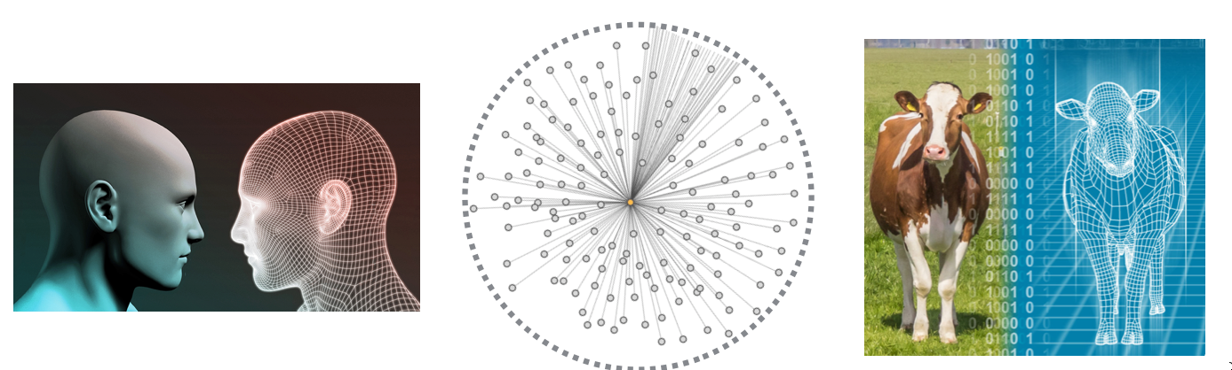
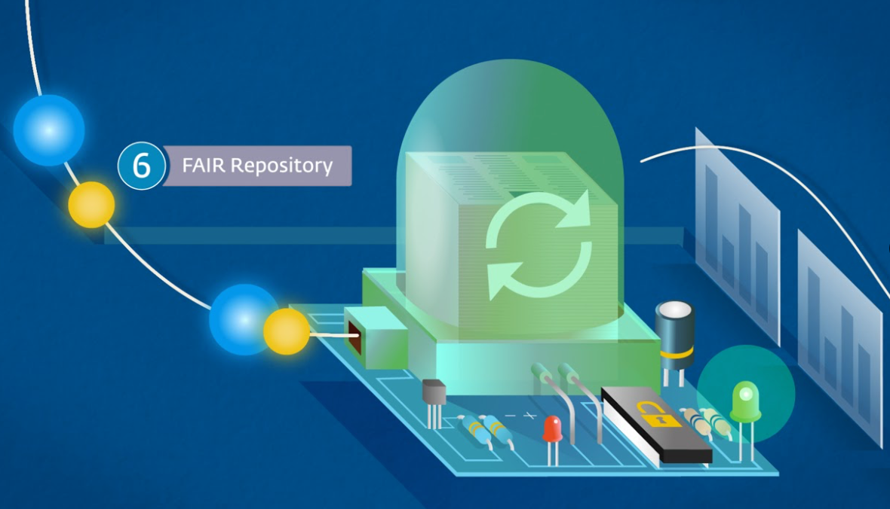
Digital Twins are a type of Digital Objects
Physical Objects
Can have
Digital Twins
Metadata
Are Digital Objects
Can be a physical
Object
FAIR Digital Objects are stored
In FAIR enabled repositories
(FAIR data points/stations
Can be a Digital
Object

Slide 15

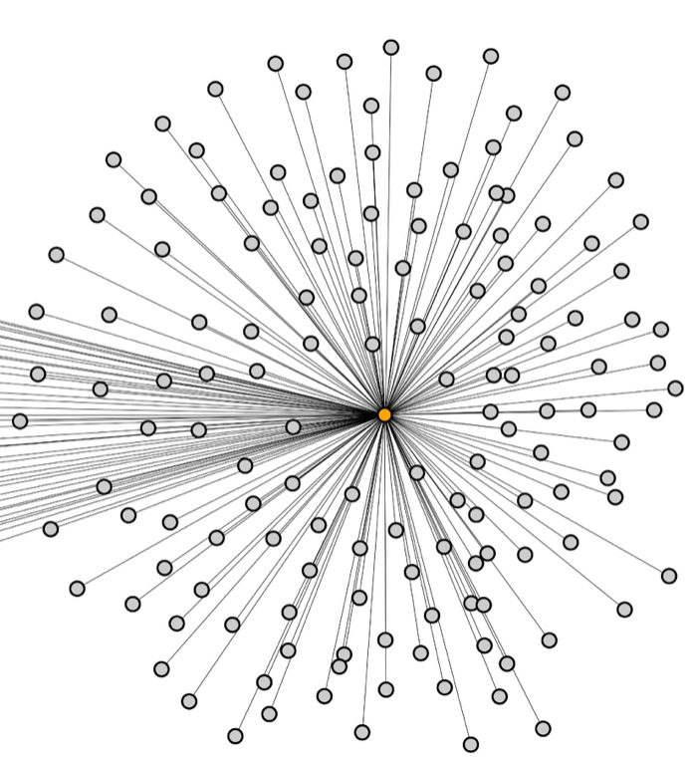

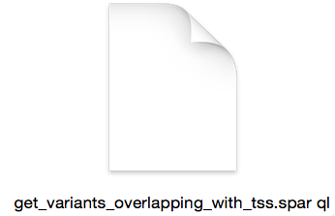
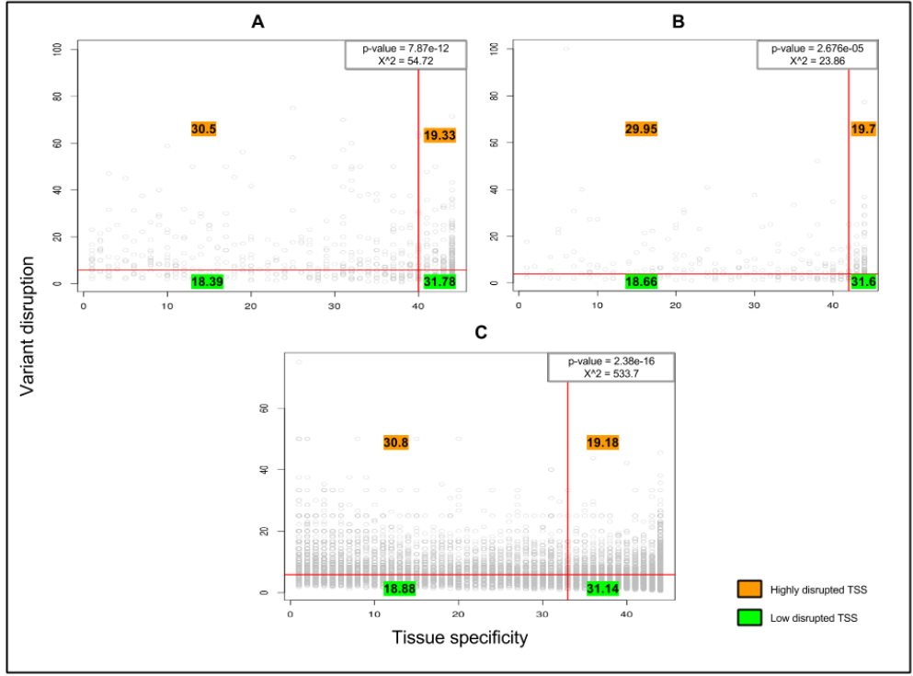



Variant-
TTS-
protein-
Pathology
similarity
measure
Disease Causing Variants

Slide 16
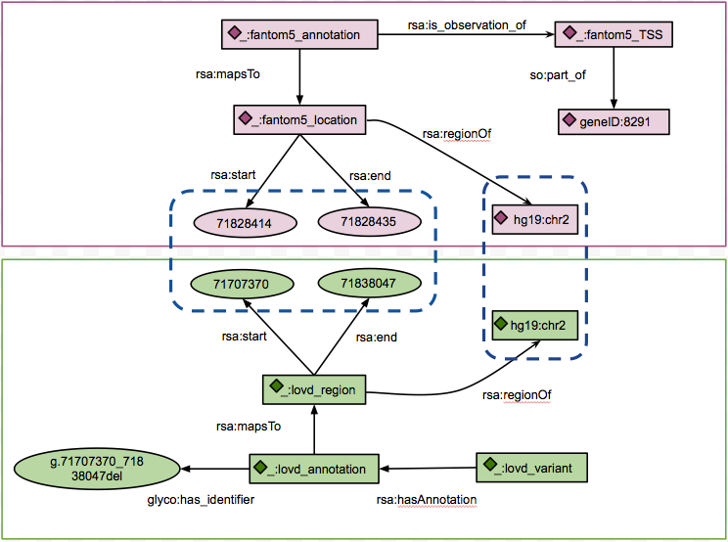


Combine
FANTOM5
&LOVD
> 20% of known
disease-causing
Variants map to TSS

Slide 17
The value of knowlets in dynamic ontological graphs
A
B
C
conceptual similarity
(hypothesis generation)
Near sameness
(semantic lenses)
conceptual drift
(meta-data/blockchain)
D
QUA’s
(semantic bias)

Slide 19
Intelligence
Ontology
Solid
Liquid
Gas
Complexity

Slide 20
Internet for (social) machines
The Machine Knows what I mean
As open as possible, as closed as necessary
As distributed as possible, as central as necessary
Global: (FAIR in Europe, Fully AI-Ready in USA) :)

Slide 21
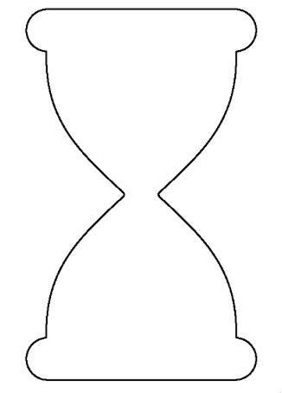

End users are domain scientists
DWARF
applications and services
VMNs, Workflows Algorithms
Data (formats)
Long tail metadata
Domain metadata
Core
Metadata
FDF
AAI
Network (routing)
Repositories
Files, Cloud, FDO storage
Flash, DNA, Tapes, (HP)C
Geant
Notes:
The basic idea of the `internet of FAIR data and services/hourglass model should ideally be the guiding principle for both the EOSC partnership and the Decadal CODATA plan. I pitch to write in the decadal plan how the various functions of CODATA, GO FAIR and RDA (mainly the former two) should evolve and potentially merge. Some functions may be shifted from GO FAIR to CODATA and some may be taken over (at least for Europe) by the new, envisioned twin sister organisation (here for fun characterised as Data Web And Resources Federation (DWARF) :)
If we all agree that these twin sister organisations ar ‘joined at the hip’ by the FDO consensus and code we have a basis for a consistent and modular collaboration basis

Slide 22




domain researchers
ESFRIs Unions
Generic
Templates
FDO
Notes:
Looking ‘up’ form the centre of the hourglass:
In the center is the FAIR digital object ~(global agreement)
Around it, generic metadata templates (super disciplinary) for all RO’s (DO’s)
Then domain specific metadata templates (typically created in M4Ms wih domain specialists)
DSCC’s fine tune metadata templates for their local situation (restricted dropdown etc.)

Slide 23
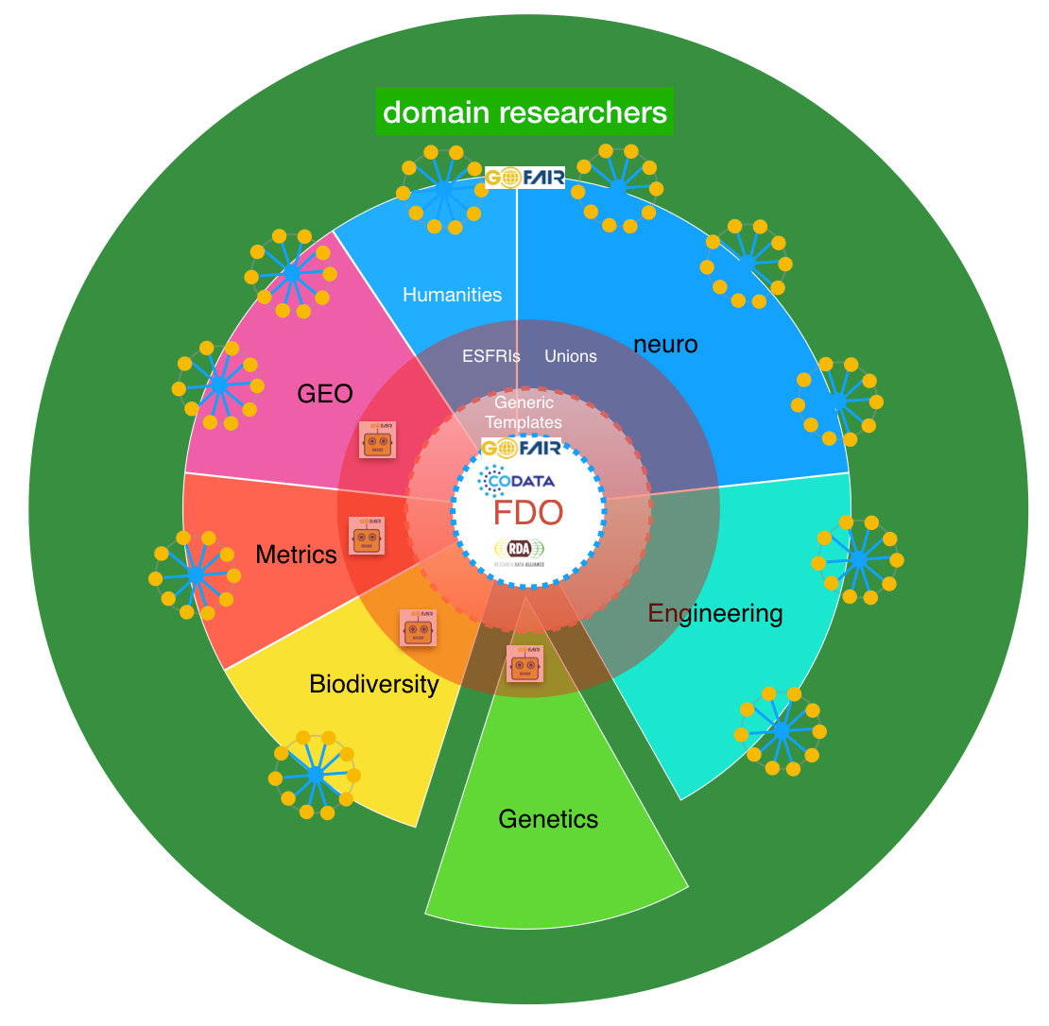
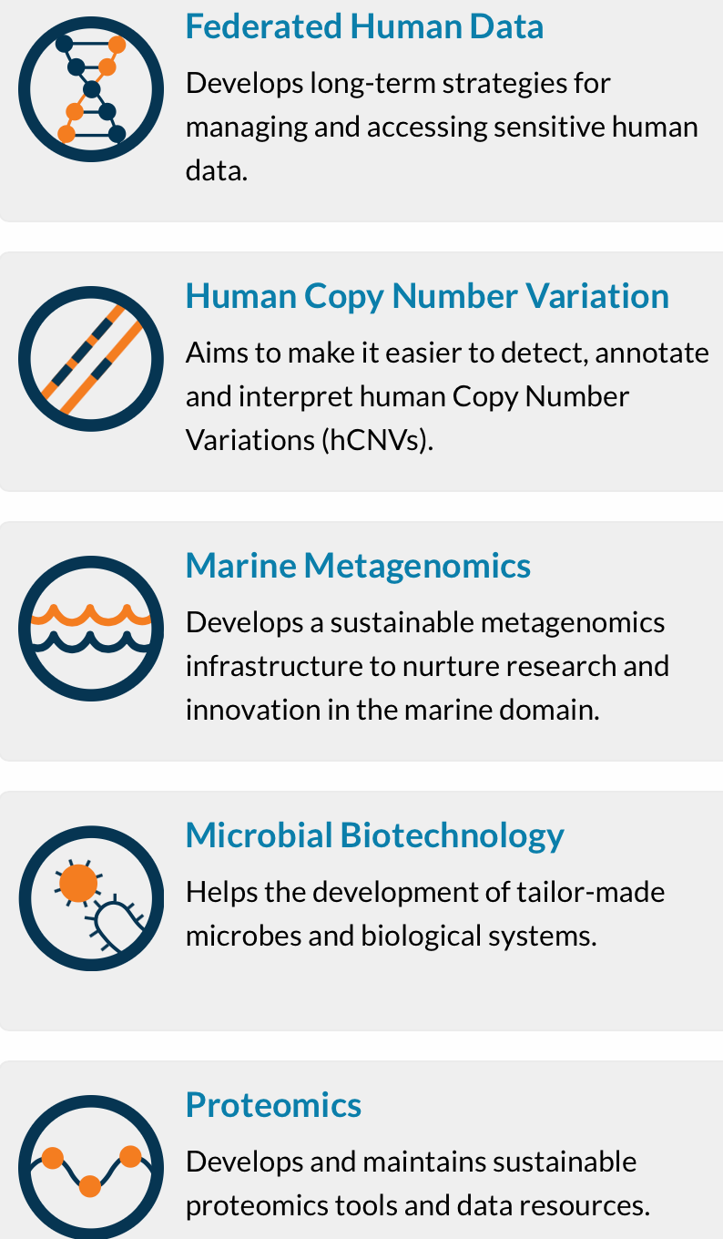


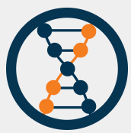



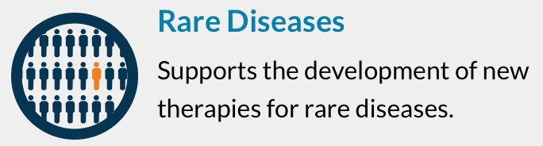
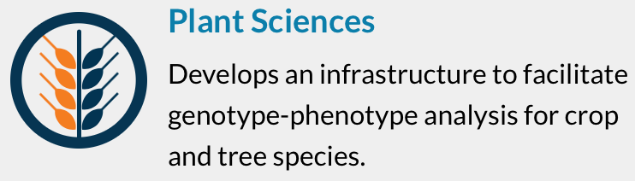


Metadata = FDO
Generic templates
Basic genomics
Bioinformatics
RNA
Methods
LUMC instruments
End users
Notes:
An example of a domain with (CODATA) champion organising the meetings and templates in this case for genetics.
All other domains will need a champion (via Unions, federations or other standing organisations mostly)

Slide 24
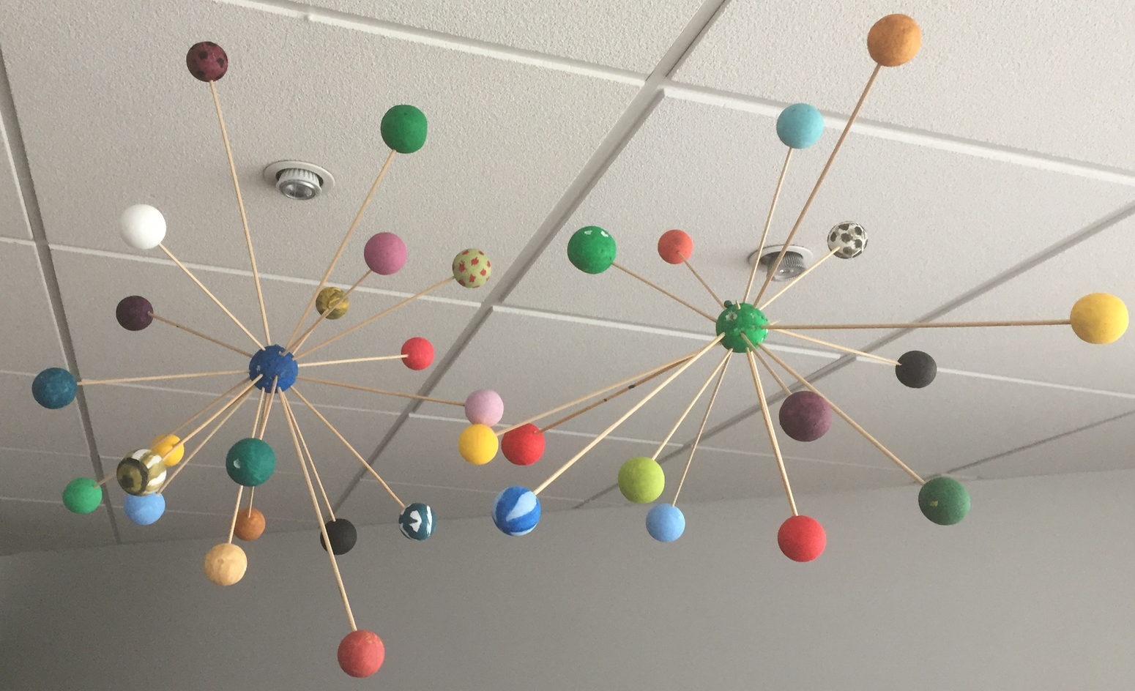
Thank you!
and
’see you at your data’

